Slide 1
DataHack 2022
Dataset Description Presentation

Slide 2
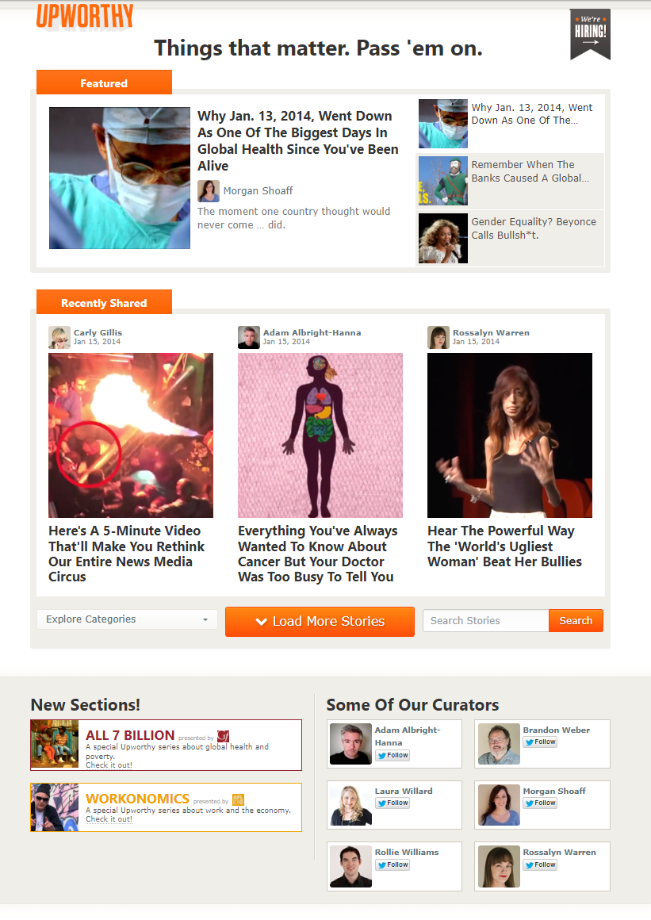
The Challenge
The challenge for DataHack 2022 relates to Upworthy, a blog that has historically used clickbait to create viral trends and establish its userbase.
Sometime during the dataset, Upworthy claimed that they stopped using clickbait to promote their articles and grow their website.
Upworthy frontpage in 2014
Notes:
If time permits, go to https://web.archive.org/web/20140115162440/http://www.upworthy.com/ and show people a short demo of what Upworthy looked like in 2014.

Slide 3
The Challenge
Is Upworthy’s previous claim about abandoning clickbait true?
As a data scientist in private equity, your job is to determine whether your firm should invest in Upworthy. To answer this question, your team should analyze data from Upworthy and determine how the company has changed over time and whether those changes are good for the company.
Upworthy frontpage in 2014
Notes:
Your team will have three main questions to solve, outlined in the dataset description packet.
Did Upworthy really change their clickbait publishing practices?
What was the impact of that change?
Do you recommend an investment in Upworthy?

Slide 4
The Dataset
The dataset includes 3 important .csv files for answering these questions.
upworthy-archive contains information about A/B tests from upworthy.com
daily-user-info contains information about upworthy.com aggregated over time
country-data contains information about upworthy.com aggregated by country
Notes:
Explain each of the 3 datasets
Upworthy archive is the main dataset you’ll be using. It contains data about a ton of A/B tests that Upworthy has conducted in the last decade, where they vary the headline and article image and see what generates the most clicks. More info on this next slide.
Daily user info contains a time-series about how Upworthy.com has grown or shrank over time. It looks at user logins, new registrations, and a bunch of other important variables.
Country data looks at those same variables aggregated by country. So if you want to take a geographic perspective on the data, this dataset will be useful for your analysis.

Slide 5
What is an A/B test?
An A/B test is a randomized experiment where a portion of the users are shown variant A and another portion are shown variant B.
In this dataset, users are shown different packages, which are different versions of headline + picture for the same article
Usually, upworthy wants to maximize clickthrough rate for each package! (clicks per exposure). This is why Upworthy is known for their clickbait.
Notes:
An A/B test is a randomized controlled experiment where for each article, the user is shown a random choice of one of many packages, which is a combination of article title + article image. Then, upworthy.com measures which package performs the best and uses that for the rest of the website one the test is over. Usually, upworthy.com selects the most successful package by maximizing the clickthrough rate for their users. This may result in clickbait article titles, which is why Upworthy has been accused of spreading clickbait for their content.

Slide 6
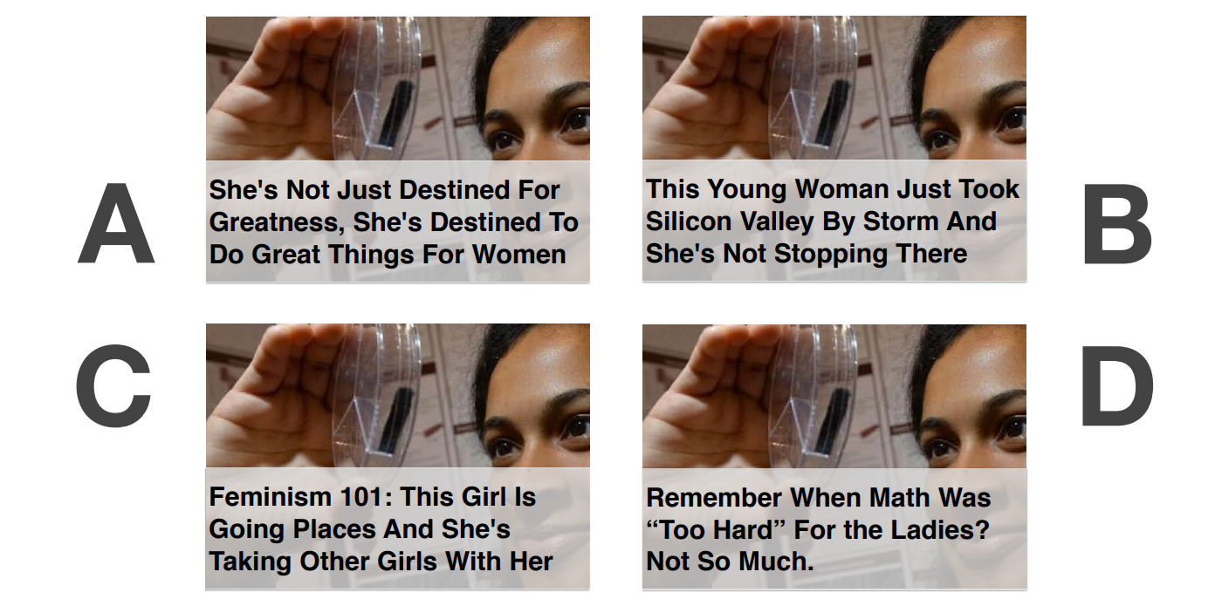
A/B Test Example
Example of a package = headline + article picture
Notes:
If you aren’t familiar with what an A/B test is, heres an example: each user will get 1 or 4 of these packages. Each package will have a different article title and possibly a different image. From Upworthy’s perspective, their goal is to pick the package which maximizes the clicks for their articles. So naturally, they’ll pick a package accordingly.

Slide 7
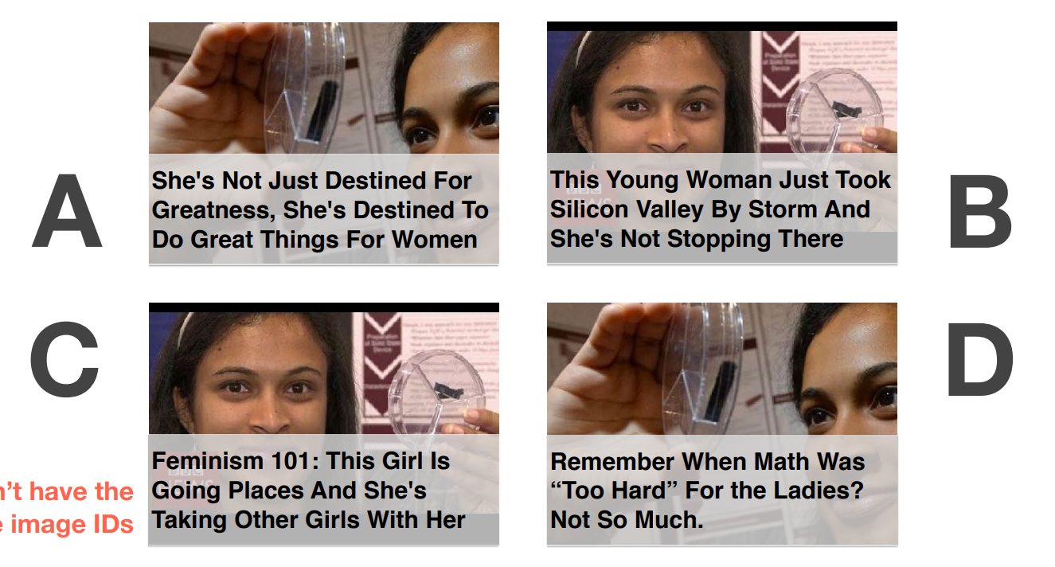
A/B Test Example
IMPORTANT: Not all packages have the same image! Sometimes, both title and image can vary by package!
Notes:
But based on our definition of package, sometimes the packages vary by just the title and other times they vary by both the title and the image! So maybe that’s something you want to consider in your comparisons.

Slide 8
A/B test specifics
ab_test_id represents an A/B test for a specific article
For each A/B test, a user sees one of many potential packages
Also for each A/B test, only the article headline and article image vary. Everything else about the article stays constant across packages.
The Upworthy editor may or may not select the best-performing package
At the end of each A/B test, Upworthy measures clicks and exposures for each package to calculate how successful the package was. Then, Upworthy determines a winner.
Notes:
Basically read off this slide

Slide 9
Ways your team could tackle the problem
Using natural language processing (NLP) to measure/quantify clickbait (using ML to predict clickbait based on text)
Using time-series tools to analyze website characteristics before/after Upworthy’s no-clickbait pledge (analyzing the time-series characteristics of upworthy.com before and after they made a no-clickbait pledge).
Analyzing impact in terms of financial/growth/ethical implications (understanding + assess their future business plan)
Building a compelling dashboard/visualization in the context of the key question
Notes:
Here are some ways to tackle the problem (basically read off this slide).

Slide 10
How will your team be evaluated?
Creativity: How novel are your ideas? Is your submission exciting?
Judges will be looking for how unique your ideas are compared to other teams/what is widely available on the internet.
2. Technical Mastery: Is your proposal technically correct? Did you use any interesting technologies?
Judges will be looking for technical correctness (no technical mistakes, how interesting is the problem approach and solution, is your presentation unique).
3. Quality: How effective is your presentation? How polished is your code? How
well can you sell your idea?
Judges will be looking for overall quality in terms of code, presentation, and pitch
Each category is weighted equally by the judges 1/3
Notes:
Here is how your team will be evaluated (basically read off the slide).

Slide 11
Rooms you can work in
6.302
4.304
5.304
5.302
2.502
1.304
2.402
You can work on any of the bridges too (3,4,5,6th floor)
Notes:
Here is how your team will be evaluated (basically read off the slide).

Slide 12
Any questions?
Feel free to ask now, or mentors will be available throughout the day to answer your questions about the dataset or how to approach the problem!
Notes:
Here is how your team will be evaluated (basically read off the slide).

